Slide 1
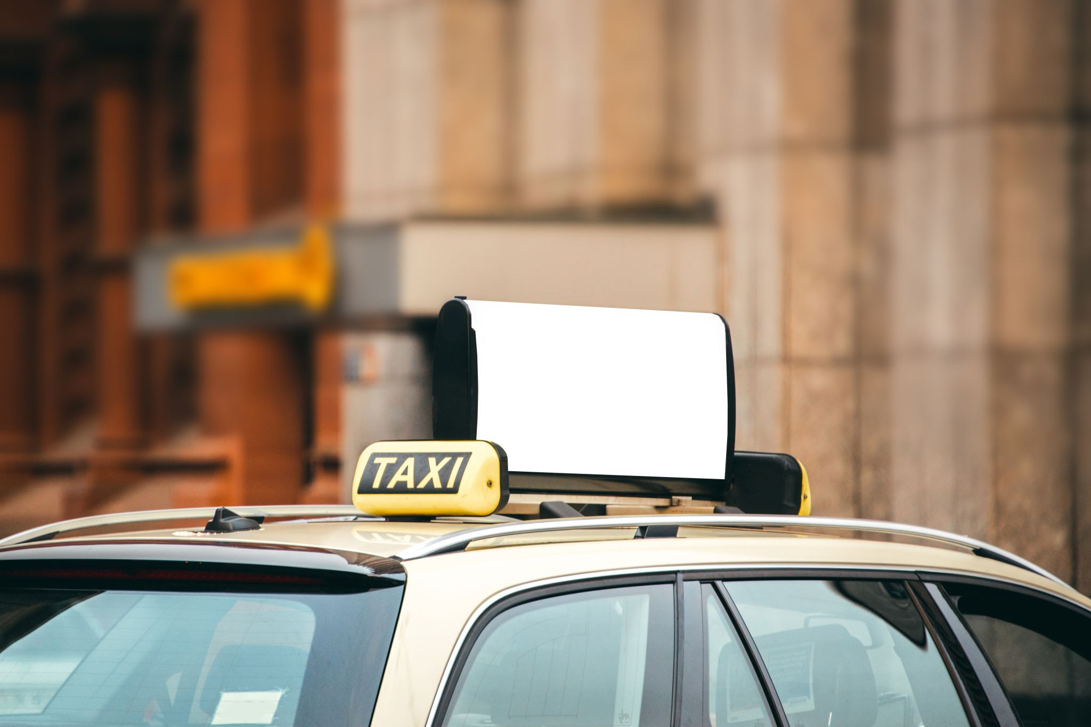
Vehicle License Plate Detection using YOLOv8
Wenhao Fang

Slide 2
Introduction

Slide 3
Introduction
YOLOv8, or You Only Look Once version 8, is a cutting-edge object detection model in computer vision.
deep learning algorithm
neural network

Slide 4
Introduction
This project focuses on
the hands-on skills
knowledge regarding deep learning
In subsequent sections, I will navigate through the practical steps to create a custom YOLO model to predict car plates.

Slide 5
Data Collection

Slide 6
Data Collection
Unlike the alphanumeric data commonly used in the machine learning course, the data used in this project are image-based, leading to a challenge to collect data.
While manually collecting images from daily surroundings, such as capturing vehicle plates on busy city roads, is an option, it proves time-consuming and burdensome, especially given the nature of media data.

Slide 7
Data Collection
To address this challenge, I used a Google image downloader named 'simple-image-download’.
a Python script to search for and download images from Google Images.
I listed various keywords of automotive brands to simplify the collection process and ensure a diverse dataset for YOLO model training.

Slide 8
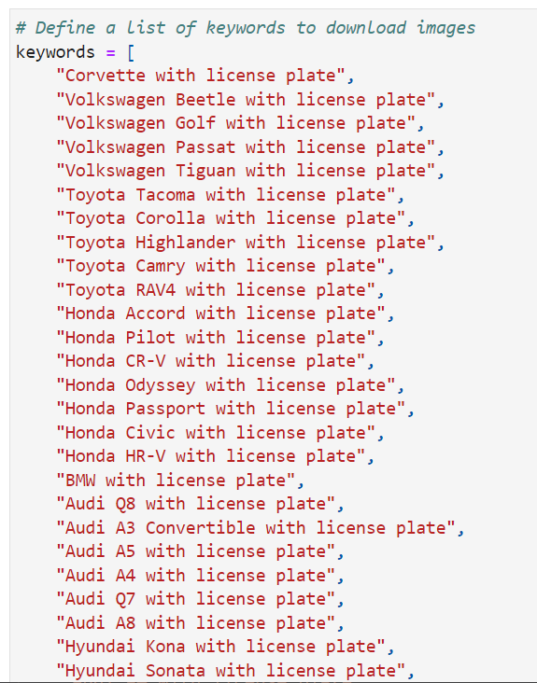
Figure 1.Keywords list

Slide 9
Data Processing

Slide 10
Data Processing
Data Cleansing
the removal of all irrelevant images, ensuring that only images in the jpeg format were retained.
Eventually, 543 jpeg files are relocated to a designated folder named "data_label_image"

Slide 11
Data Processing
Image Annotation
To train the object detector, bounding box annotations within images are required to supervise its learning.
To complete this critical task, I facilitated a Python program named "labelImg" to crop and label car plates with the class name "car_plate" for each image.

Slide 12
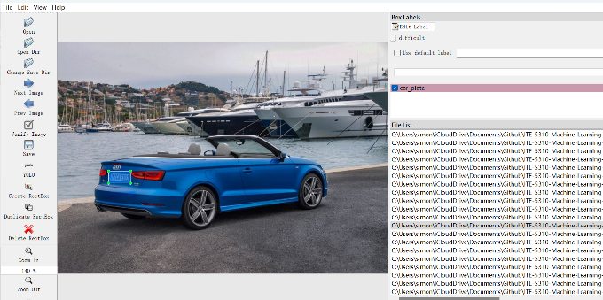
Figure 2. Object annotation

Slide 13
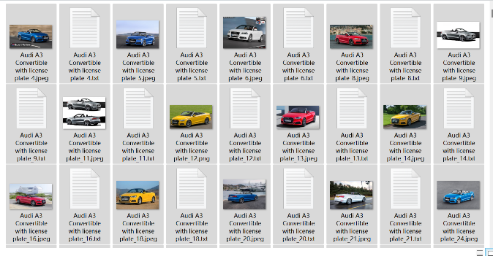
Figure 3.Images and Txt files

Slide 14
Configure YOLOv8 Environment and Model

Slide 15
Dataset Architecture
The YOLOv8 model demands a specific directory architecture for optimal functioning.
Thus, I defined a function to establish the necessary directory structure. This function efficiently splits and copies image files and their corresponding text files into distinct directories.
Files were split at a 8:1:1 (training/validation/prediction) ratio, resulting in 431 images for training, 56 images for validation, and 56 for prediction.

Slide 16
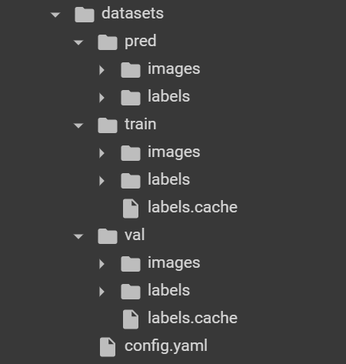
Figure 4: Dataset Architecture

Slide 17
Dedicated Environment
It is recommended to establish a dedicated environment to train a custom YOLO model.
Google Colab, a hosted Jupyter Notebook service,
the "ultralytics" library, the core library to train a custom model.

Slide 18
YOLO Model Configuration
To connect labels with images and Txt files, “config.yaml", a configuration file, was created in the "datasets" directory. This pivotal file contains the paths of train and val images, along with the label name.
This project utilizes the base yolov8n.pt model as a starting point for car plate detection using the default arguments.

Slide 19
YOLO Model Configuration
The default values of the critical arguments are:
epochs:100, number of epochs to train for,
batch: 16, number of images per batch,
optimize: auto, optimizer to use,
patience: 50, epochs to wait for no observable improvement for early stopping of training.

Slide 20
Train a Custom YOLOv8 Detector

Slide 21
YOLO Model Configuration
At the beginning of the training, more detailed arguments were shown.
For example, the optimizer used in this project is AdamW, a gradient descent method. The learning rate was 0.002 and momentum was 0.9.
During the training process, a suite of crucial metrics for each epoch, including box_loss and cls_loss, were continuously displayed.

Slide 22
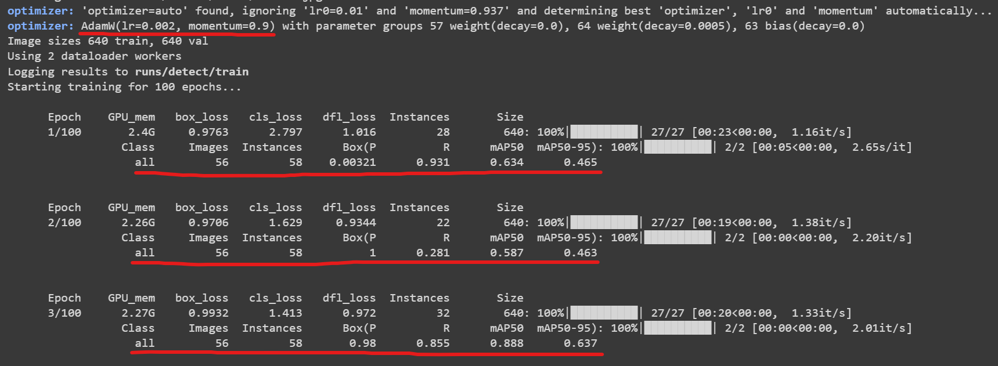
Figure 5: Metrics

Slide 23
Performance Evaluation

Slide 24
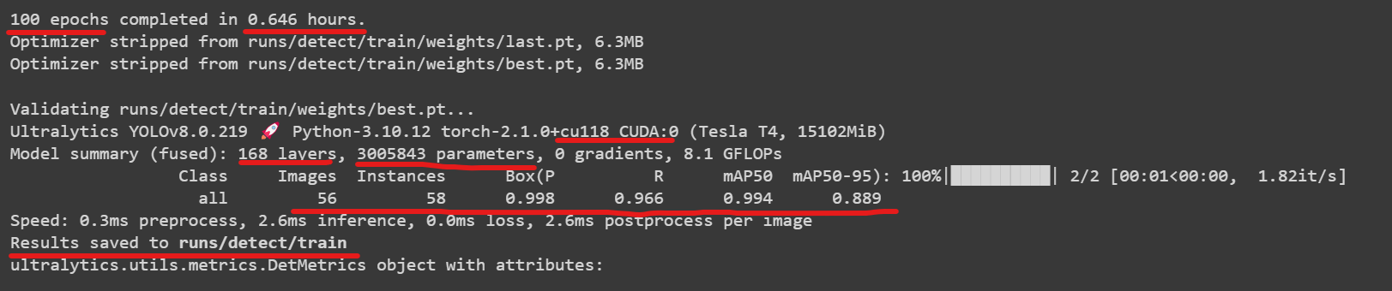
Performance Evaluation
A summary was displayed when the training was completed.
Figure 6: Model summary

Slide 25
Performance Evaluation
Train
100 epochs
0.646 hours
validation
56 images / 58 instances

Slide 26
Performance Evaluation
The P (Precision) value is 0.998, which means more than 99.8% of detected car plate are correct.
R (Recall) value is 0.966, presenting the model can correctly identify all relevant instances from the total actual positive instances.
The mAP50-95 value is 0.889, indicating that the model can correctly detect target objects at varying IoU(intersection over union) thresholds, ranging from 0.50 to 0.95.

Slide 27
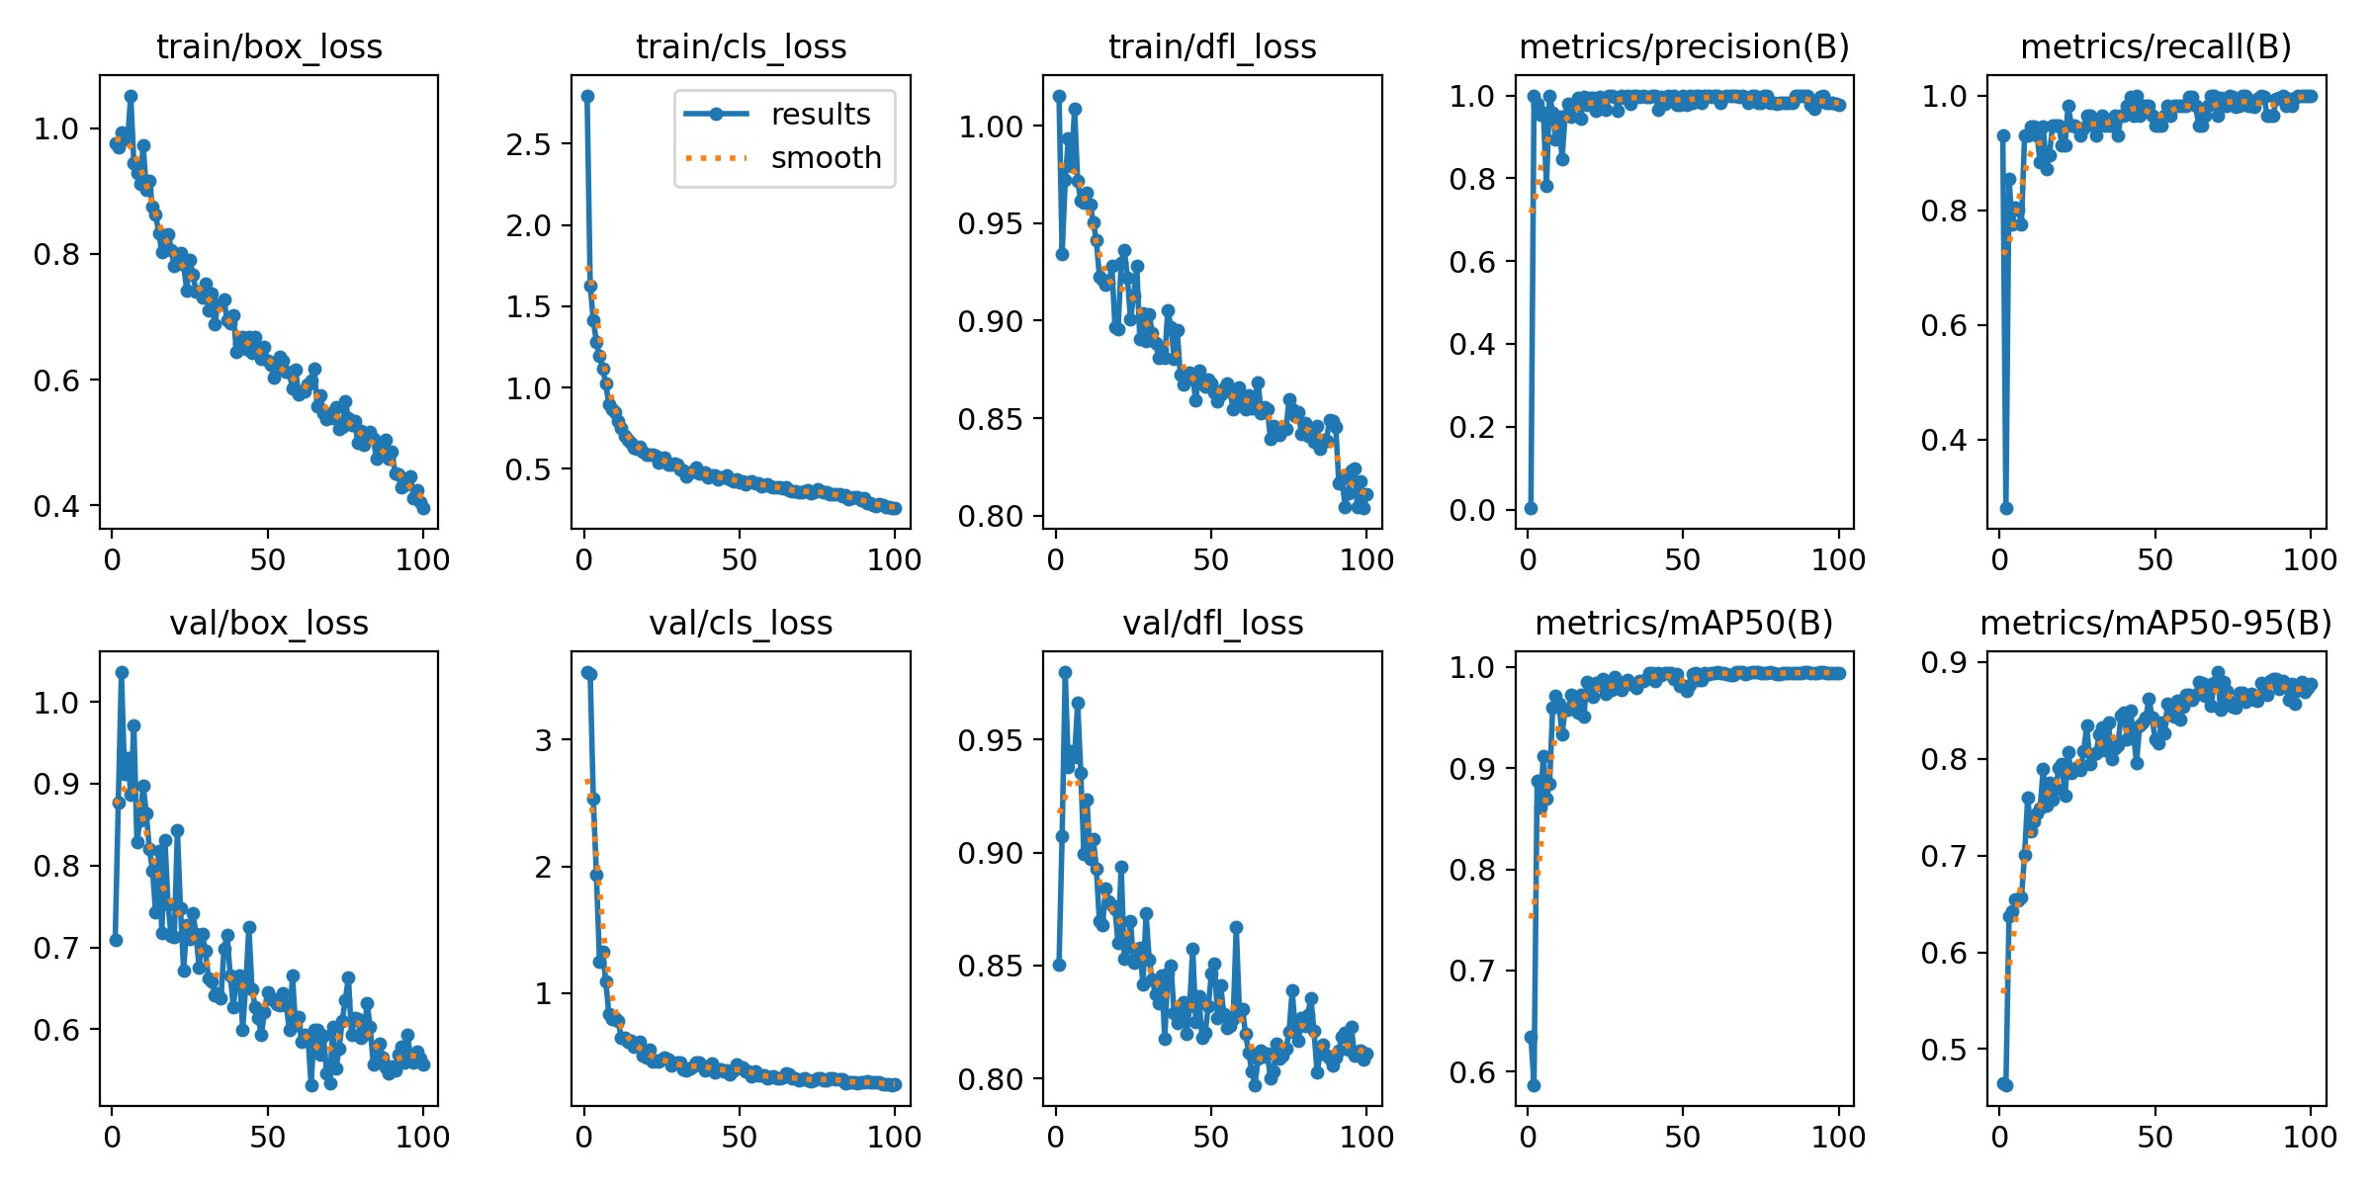
Performance Evaluation
a series of detailed metrics were available in the "runs" directory.
Figure 7: Metric against epoch

Slide 28
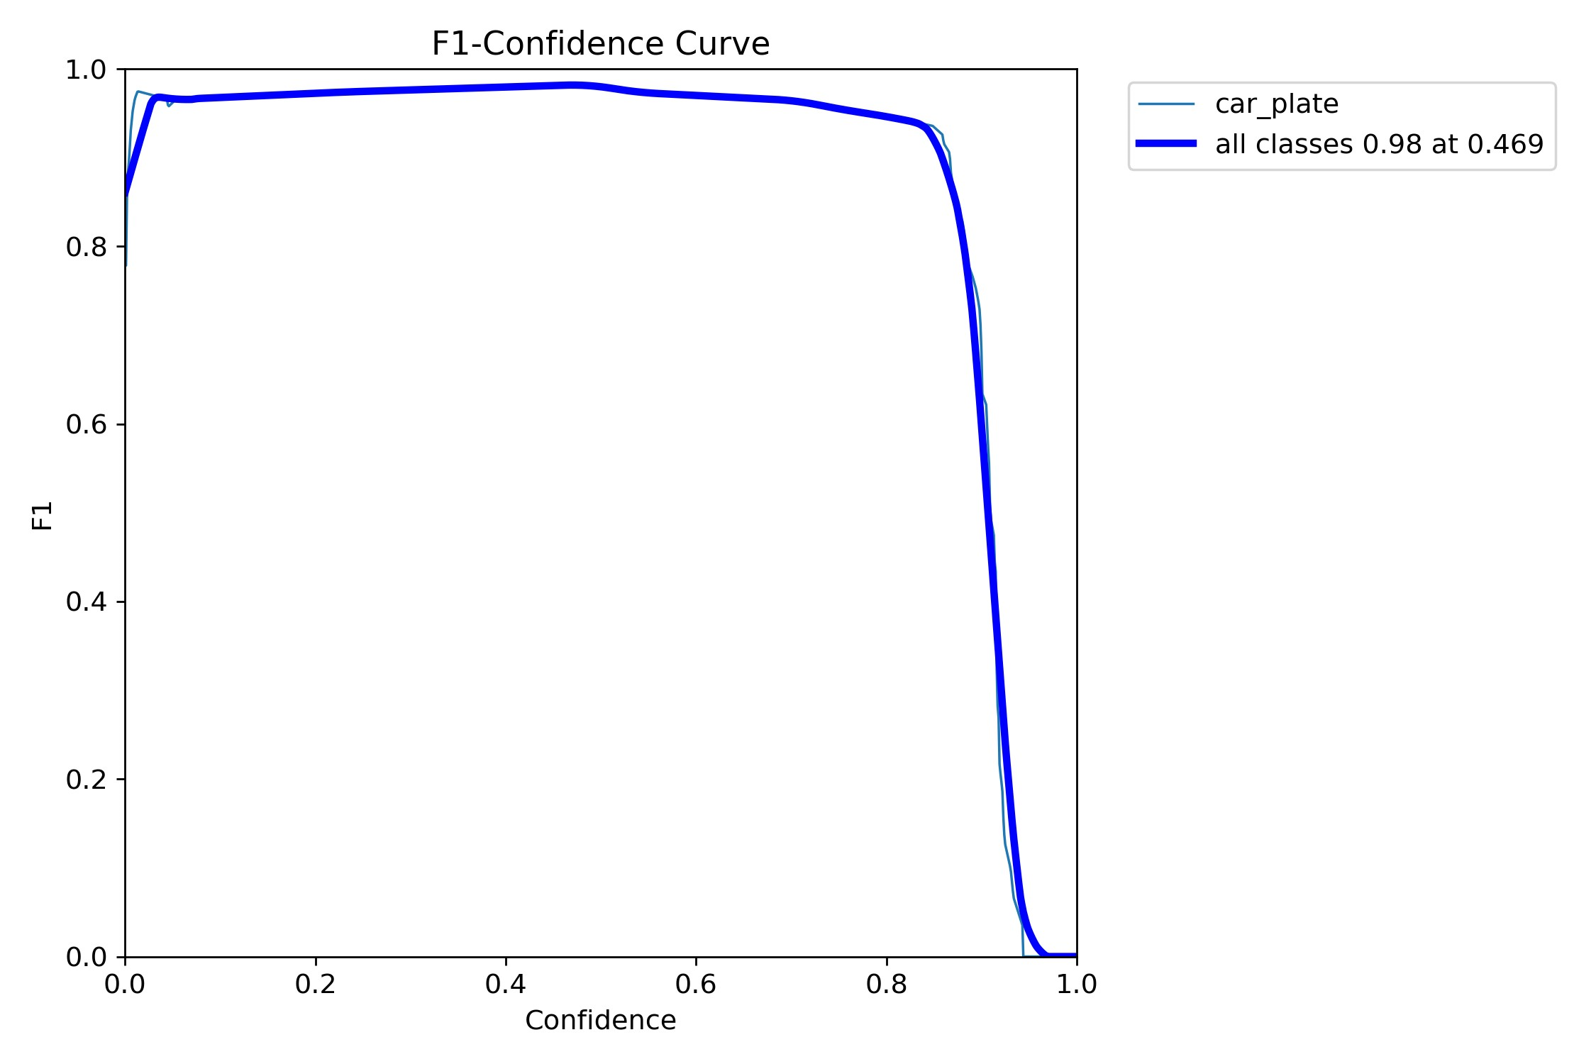
Performance Evaluation
F1 score, a metric that combines precision and recall into a single value, is close to 1 in the range of 0 and 0.8 confidence, indicating that within this range confidence the model has a good overall performance.

Slide 29
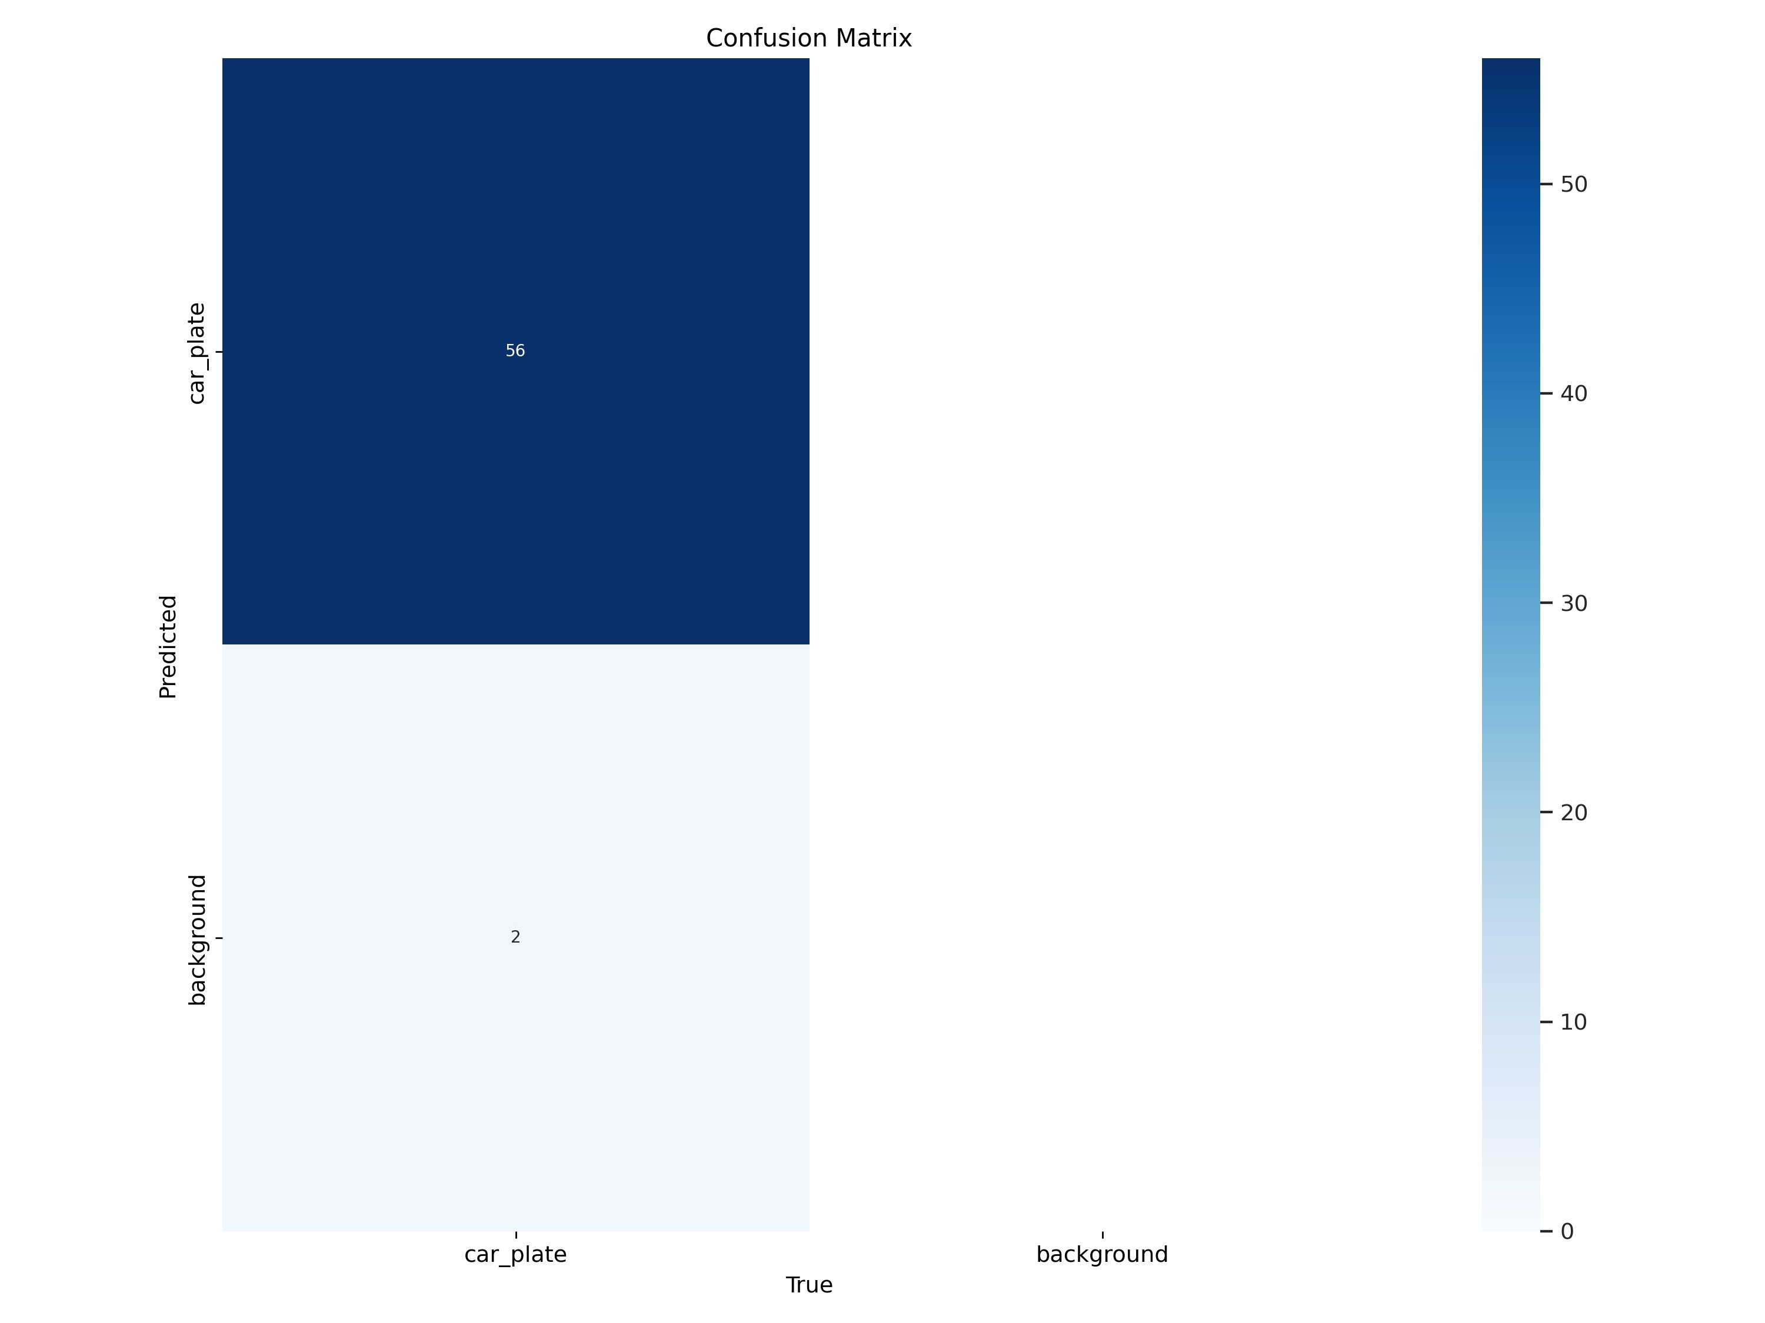
Performance Evaluation
The confusion matrix presents the custom model correctly identified 56 car plates but misidentified 2 car plates as background.

Slide 30
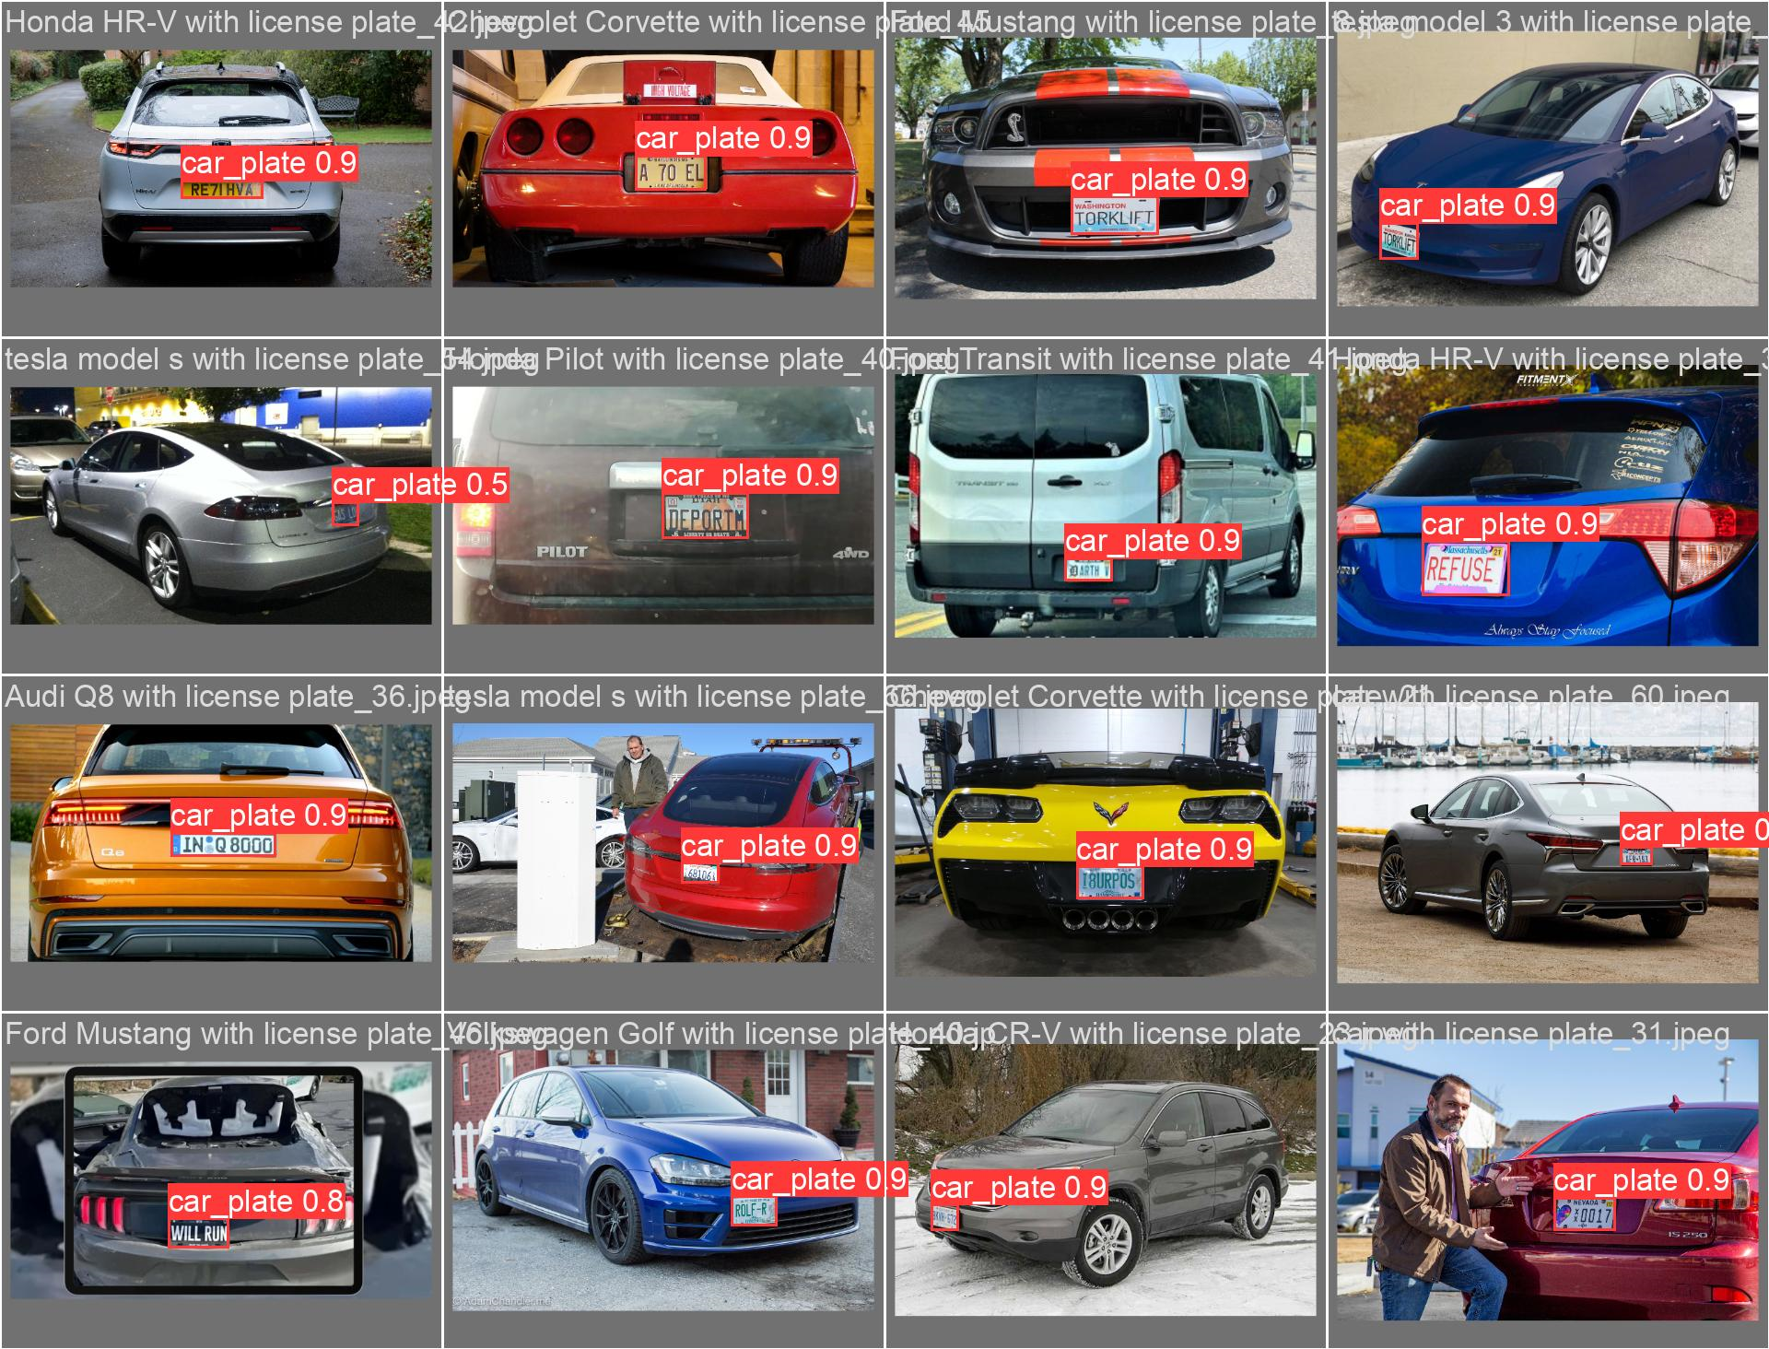
Validation

Slide 31
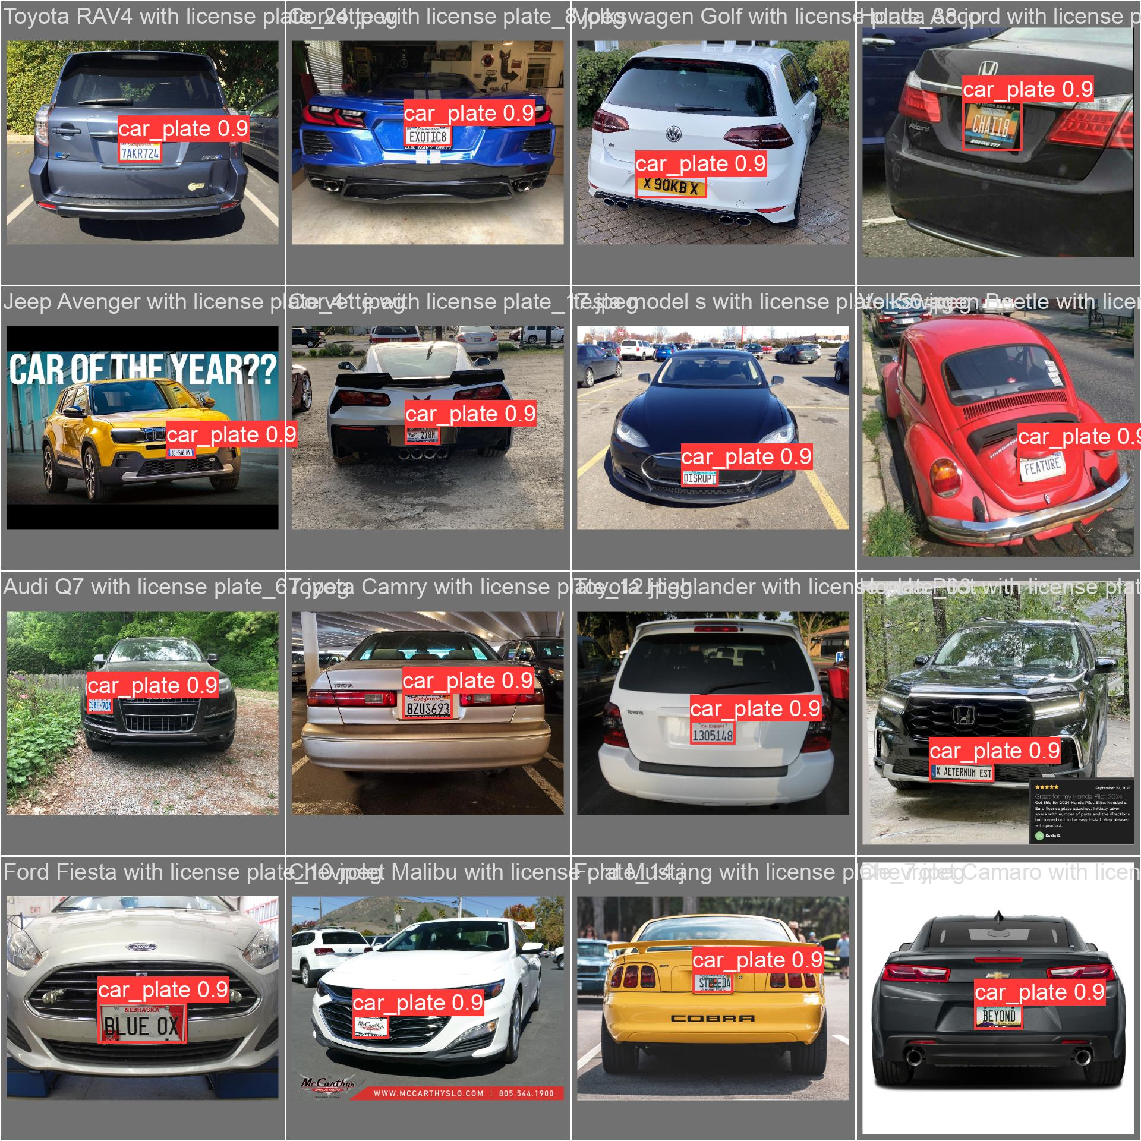
Validation

Slide 32
Predict Using the Custom YOLO Model

Slide 33
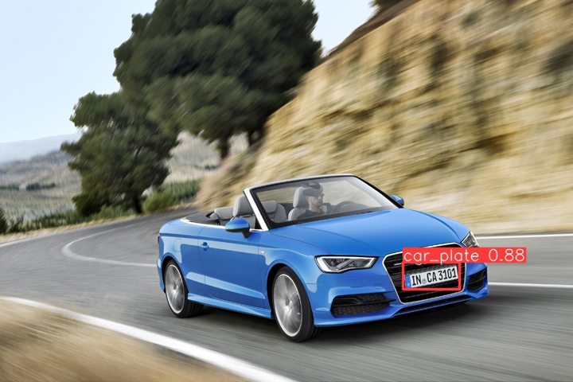
Figure 10: Prediction

Slide 34
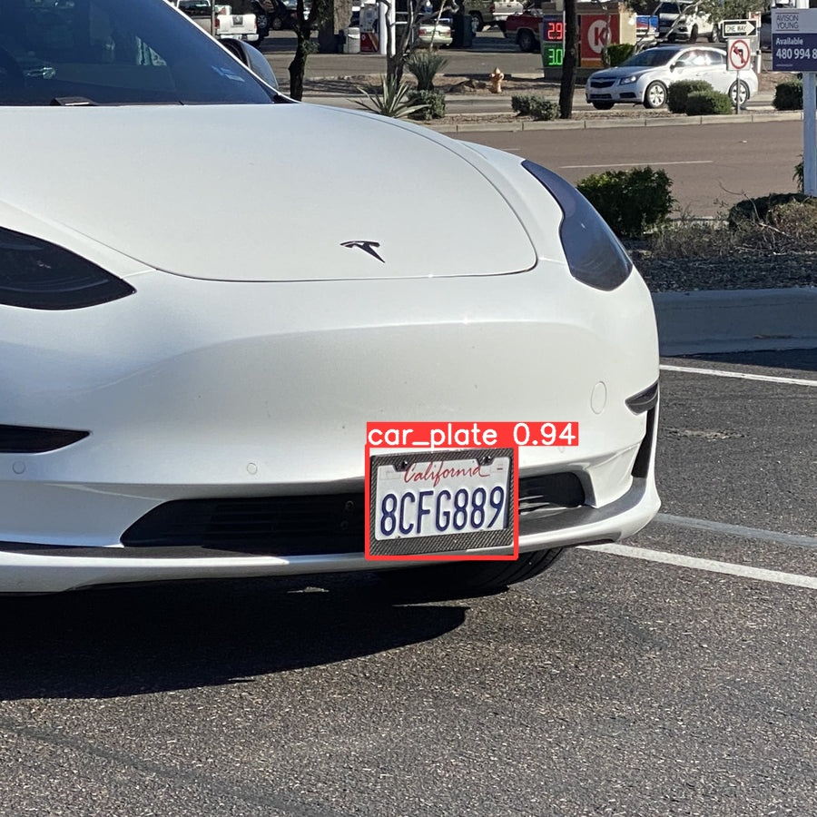
Figure 11: Prediction

Slide 35
Pipeline to Train YOLO Model

Slide 36
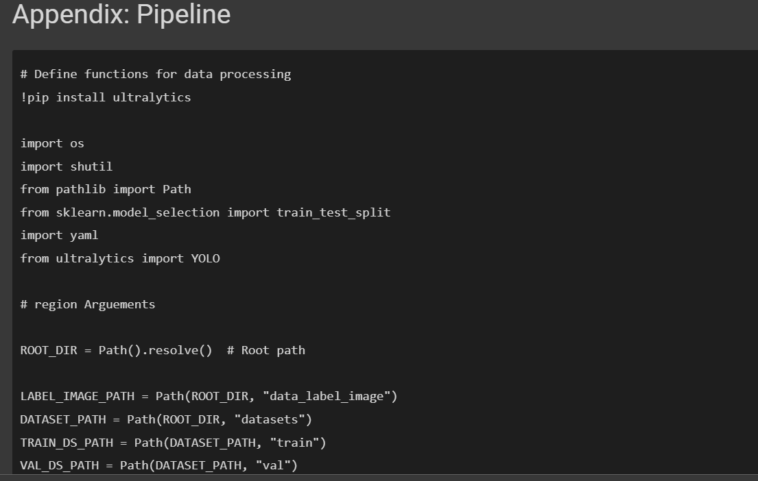

Slide 37
Summary

Slide 38
Summary
a custom model for car plate prediction.
Data collection
Data processing, cleansing + annotation
Yolo model configuration
Training the custom YOLOv8 detector
Performance evaluation
Car plate prediction
Pipline

Slide 39
References

Slide 40
References
Glenn, J., Abirami, V. (2023, November 18). Performance Metrics Deep Dive. Ultralytics. https://docs.ultralytics.com/guides/yolo-performance-metrics/
Glenn, J. (2023, November 25). Model Training with Ultralytics YOLO. Ultralytics. https://docs.ultralytics.com/modes/train/

Slide 41
Github
https://github.com/simonangel-fong/ITE-5310-Machine-Learning-Assignment10

